Slide 1

Team Name: BLOCKHACK
Nov 30th – Dec 2nd 2018 | National Incubation Center, Karachi
Challenge Theme: MOBILITY & TRANSPORTATION
Team Participant Names:
1. Abdul Moiz Hussain
2. Jawwad Ansari
3. Muhammad Kamil Amin
4. Tahir Talib Hussain
5. Zubia Anwar Malik
Solution leverages:
Bing Maps API
Firebase/ Firestore
React JS
React Native

Slide 2
Civic Tech Hackathon 2018 | Problem-Solution Fit
Passengers usually find difficulties in tracking their transports; whether the bus has crossed their designated stop or not.
Musafir App for bus networks enables their passengers to monitor and real-time book their transit options from their location.

Slide 3
Civic Tech Hackathon 2018 | Potential Impact
Millions commute everyday.
Safe and secure tracking of bus networks.
Real-time data on most to least active stops/regions.
Catered to Karachi traffic.
Our Goal: Success on Private Networks = Success on Public Networks

Slide 4
Civic Tech Hackathon 2018 | Novelty & Learning
Many Bus Network and Tracking Apps available internationally but no such implementation in Karachi.

Slide 5
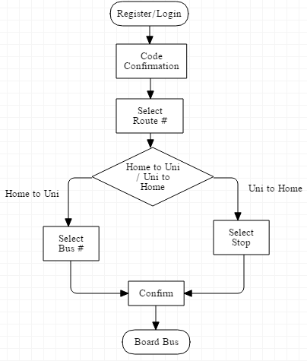
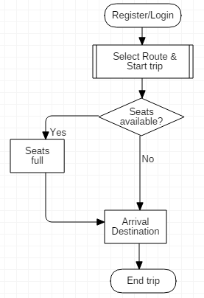
Civic Tech Hackathon 2018 | Prototype
System Architecture
MODULE – A (STUDENT)
MODULE – B (DRIVER)

Slide 6
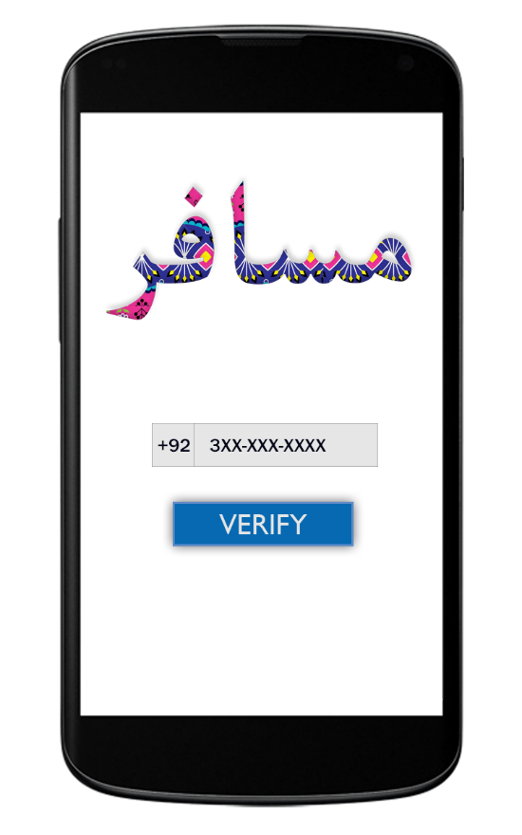
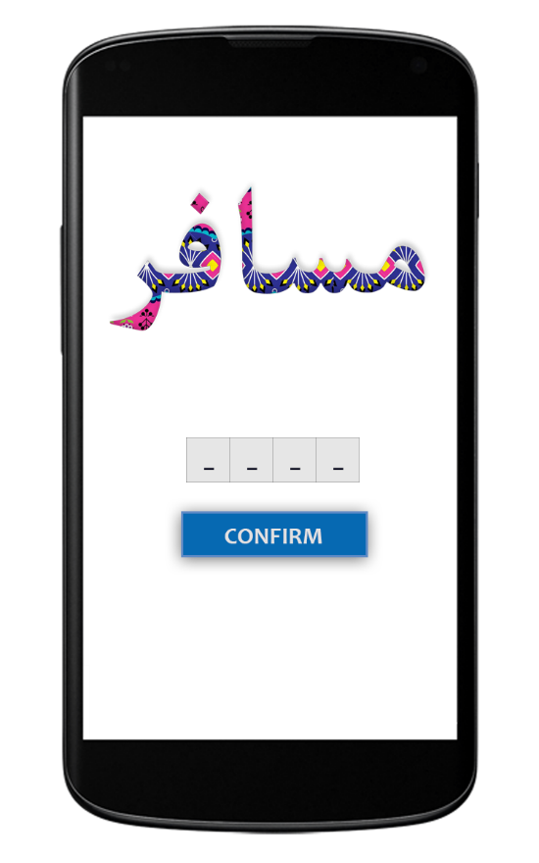
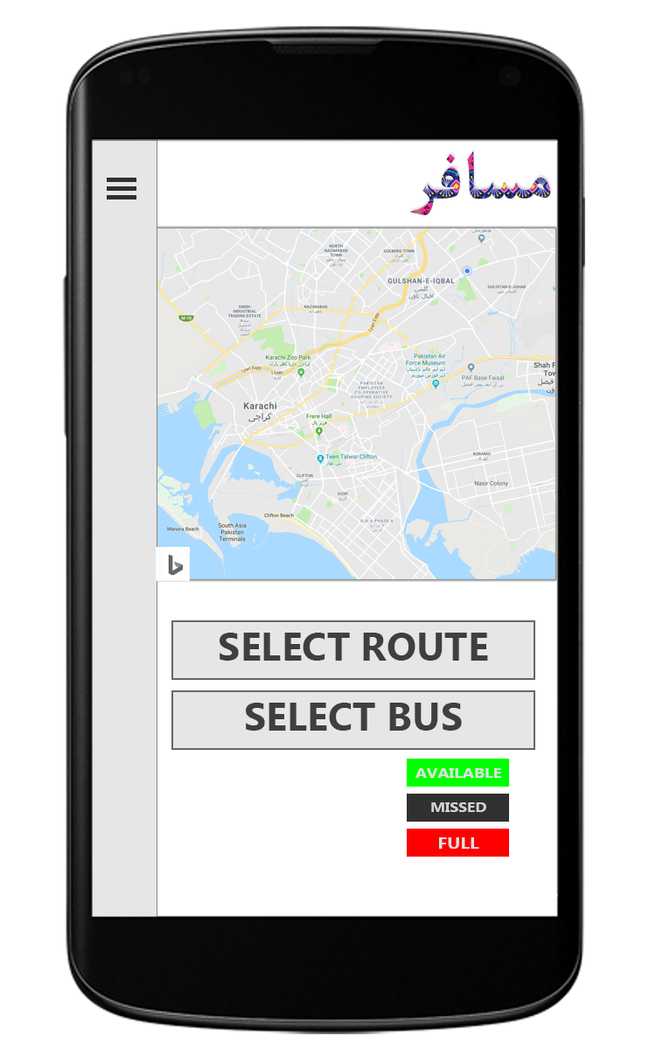
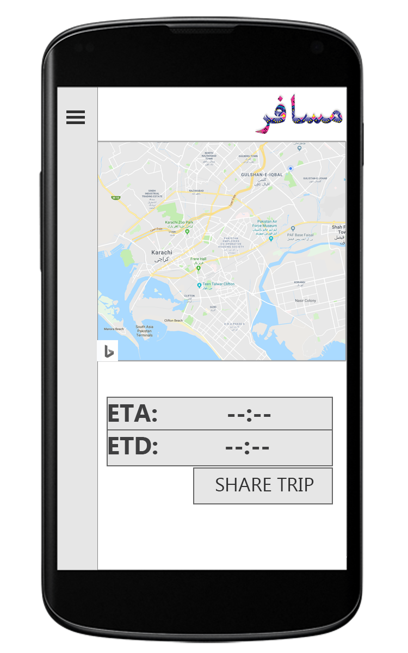
Civic Tech Hackathon 2018 | Prototype
MODULE – A (STUDENT) – UI (TO)

Slide 7
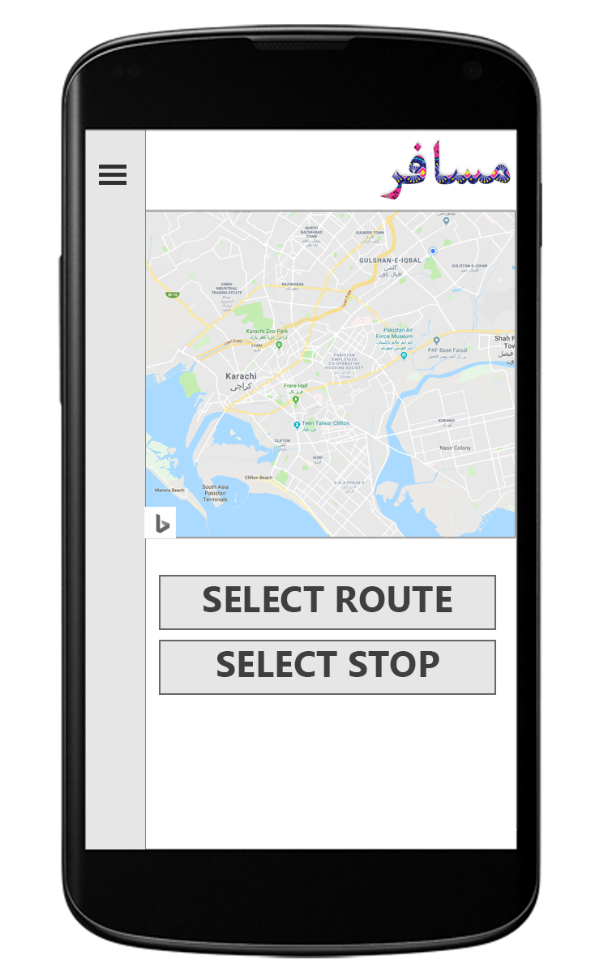
Civic Tech Hackathon 2018 | Prototype
MODULE – A (STUDENT) – UI (FROM)

Slide 8
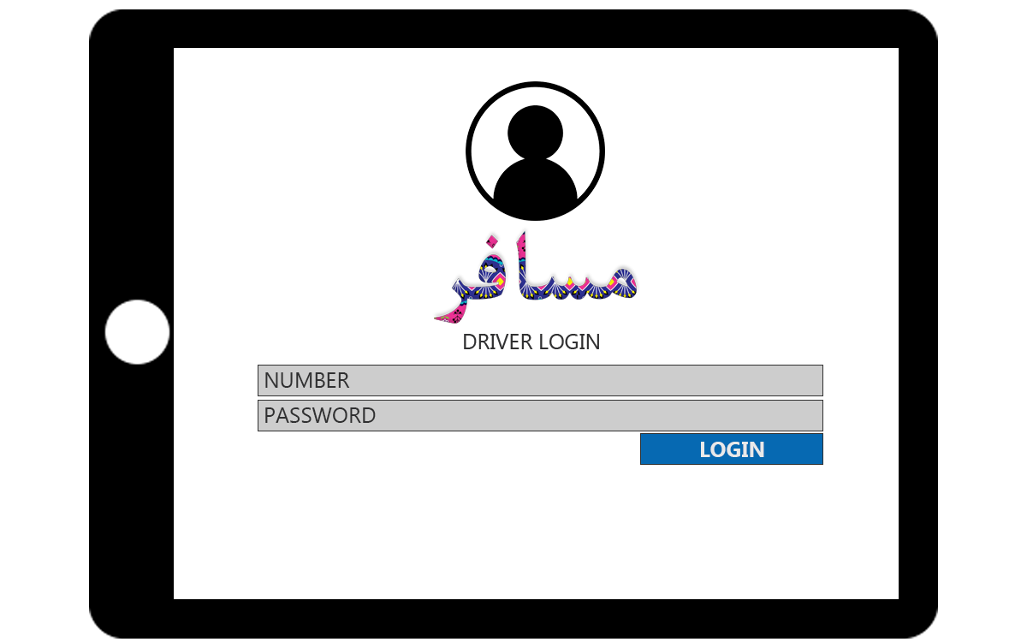
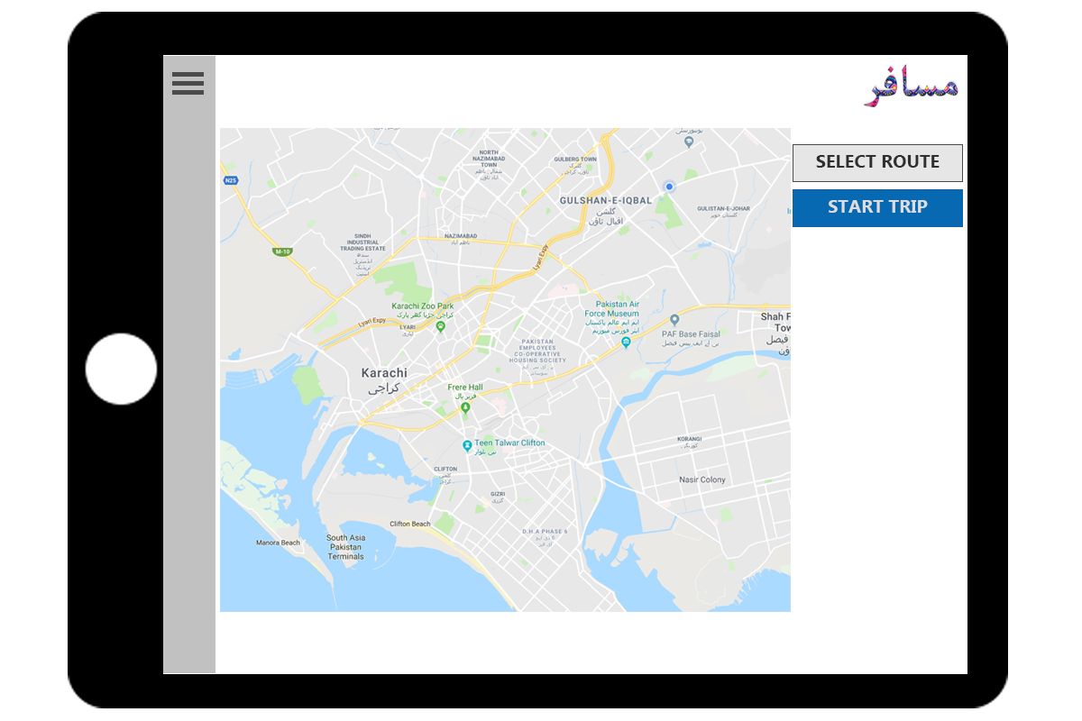
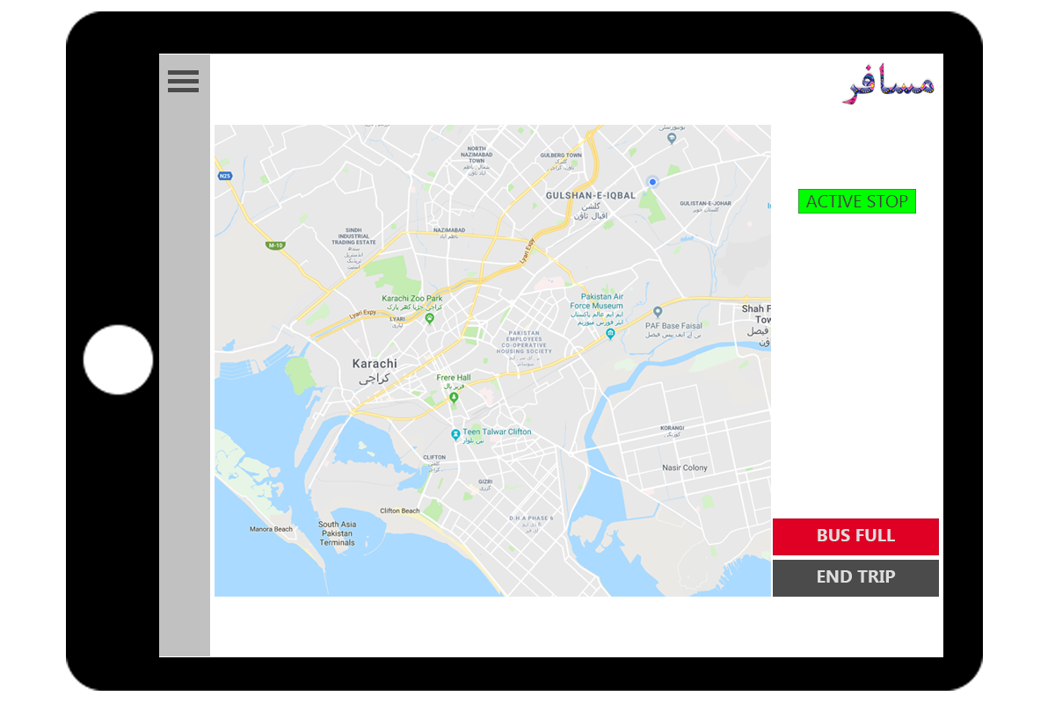
Civic Tech Hackathon 2018 | Prototype
MODULE – B (DRIVER) – UI

Slide 9
Civic Tech Hackathon 2018 | Sustainability
Musafir aims to enter the market via Private Bus Networks i.e. University Bus Networks.
Confident that success in private bus networks = success in BRT Karachi

Slide 10
Civic Tech Hackathon 2018 |
Q & A

Slide 11
Civic Tech Hackathon 2018 |
THANK-YOU!

